Slide 1

Industrial Dashboard
Team Members Name :
Muhammad Syed
Rimi Barua
Md. Jahidul Hasan
Syed Ali Redwanul Haider

Slide 2

1
Data Processing
Overview
2
Prediction
3
Visualization

Slide 3




Data Processing
Take care of faulty cells
Fix and do some calculations
Data Clean
Table Creation
Data Analyze
Understand the data
Find the errors
Find what table to make
Format and denormalize table for visualization
Make additional data based on existing data

Slide 4

Prediction
Data Gathering
Model Training
Get the data of the past three years
Create a model using Linear Regression on the data
Generating Testing Data
Model Testing
Another data was created by calculating the mean across all the data
Tested the model with this data to predict the outcome of next year

Slide 5

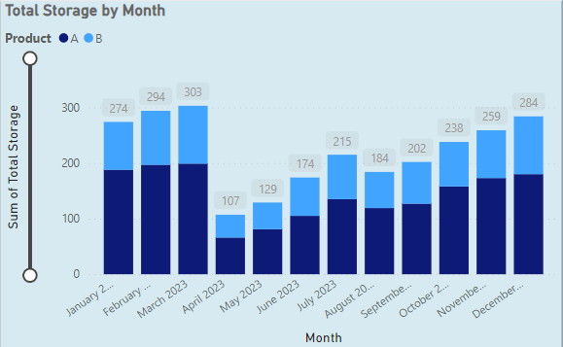
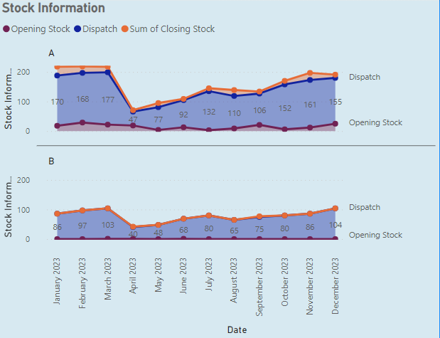
Visualization
Product Storage
Made a visualization about how much product was produced and stored in each month

Slide 6

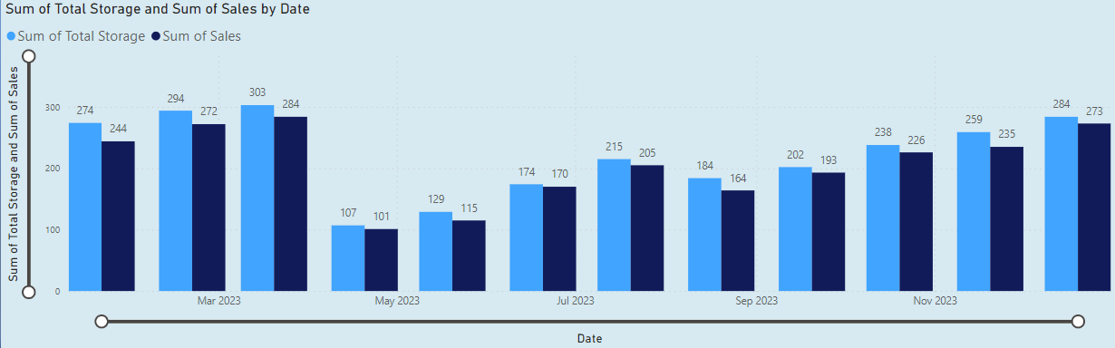
Visualization
Operation Performance
Made a visualization about how much of which product was produced and sold each month

Slide 7

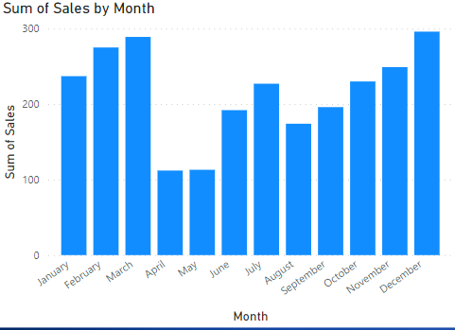
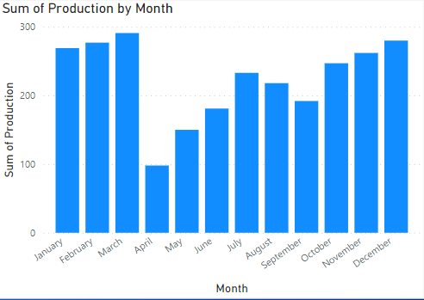
Visualization
Future Prediction
Based on the data from past years, predict future data and analyze them to help make better decisions

Slide 8


